Slide 1

AI-BASED VOICE COMPLAINT MANAGEMENT SYSTEM USING NATURAL LANGUAGE PROCESSING
DSA0306-NATURAL LANGUAGE PROCESSING
PRESENTED BY:
HDN PRAHARSHINI (192424085)
K.DEEKSHA SREE(192424097)
M JEEVITHA(192424257)
P.HITHAISHI(192425196)
GUIDED BY:D
DR.T.KUMARAGURUBARAN

Slide 2

Introduction
Traditional complaint systems rely on manual reading, categorization, and routing — slow and inconsistent.
Customers often prefer speaking over typing, especially for urgent or emotional issues.
This system captures spoken complaints, converts them to text, and applies NLP to understand intent, urgency, and sentiment.
Complaints are automatically classified, prioritized by detected emotion, and routed to the correct department.
Voice → Text → Meaning → Action
2

Slide 3




Objectives
Capture Voice Complaints
Accept spoken complaints and convert them accurately into text.
Understand Intent with NLP
Analyze complaint text to extract category, keywords, and context.
Detect Emotion & Urgency
Identify caller emotion to assign a fair, data-driven priority level.
Automate Routing
Generate structured reports and forward them to the right department instantly.
3

Slide 4




Problem Statement
Manual complaint handling does not scale — critical issues get delayed, misrouted, or lost in the queue.
Manual Effort
Delayed Priority
Routing Errors
No Voice Support
Staff must read or listen to every complaint before it can be categorized.
Urgent, emotionally distressed complaints aren't flagged fast enough.
Complaints are often sent to the wrong department, causing rework.
Most systems require typed input, excluding users who prefer speaking.
4

Slide 5
LITERATURE REVIEW:
S.No. | Author & Year | Method / Technology | Key Finding
1 | Singh et al. (2022) | NLP, Sentiment & Emotion Analysis | Improved automatic complaint identification.
2 | Singh & Saha (2023) | Graph Attention Network (GAT) | Improved complaint classification in code-mixed text.
3 | Flores Poma (2023) | NLP & Machine Learning | Identified effective preprocessing and classification techniques.
4 | Helmy et al. (2024) | Text Classification Algorithms | Compared ML algorithms for customer complaint classification.
5 | Patil et al. (2025) | NLP, Speech & ML | Combined voice/text complaints with classification and dashboards.
6 | Shree Harini et al. (2026) | Speech-to-Text, NLP & Transformers | Classified voice grievances and automatically routed them to departments.

Slide 6
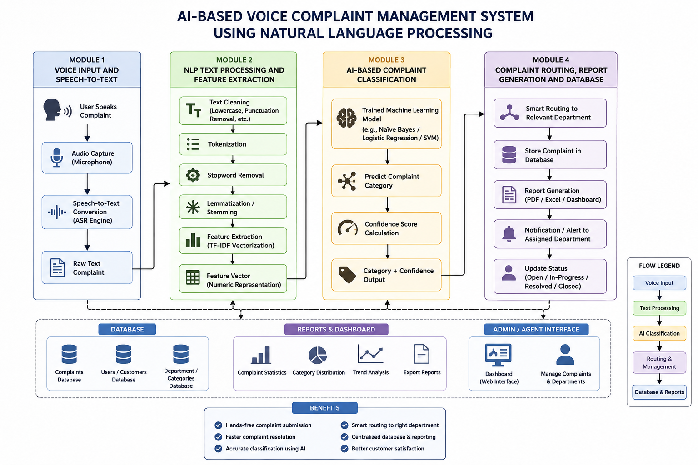
System Architecture
5

Slide 7
MODULE 1 – VOICE INPUT AND SPEECH-TO-TEXT
Algorithm/Technique: Automatic Speech Recognition (ASR)
Voice Input: The user provides a complaint by speaking through a microphone. The system captures the user's speech as an audio signal.
Audio Processing: The captured audio is processed to reduce unwanted noise and identify the portions containing actual speech.
Feature Extraction: Important characteristics of the speech signal are extracted. Techniques such as MFCC (Mel-Frequency Cepstral Coefficients) may be used in traditional speech-recognition systems.
Speech Recognition: The Automatic Speech Recognition (ASR) system analyzes the speech and identifies the spoken words.
Text Conversion: The recognized speech is converted into written text. For example, "The lift suddenly stopped" becomes the text "The lift suddenly stopped."
Output to Module 2: The generated text is passed to the NLP processing module for further analysis and classification.
Algorithm/Technique Used:
ASR / Speech-to-Text
Purpose:
Converts human voice into text that the computer can process.

Slide 8
MODULE 2 – NLP TEXT PROCESSING AND FEATURE EXTRACTION
Algorithms/Techniques: Normalization, Tokenization, Stop-Word Handling, Lemmatization and TF-IDF
Normalization: The text is converted into a consistent format by changing case, removing unnecessary punctuation and extra spaces, and standardizing the text.
Tokenization: The complaint is divided into individual words or tokens. For example, "lift suddenly stopped" becomes lift, suddenly, stopped.
Stop-Word Handling: Common words that provide little classification information may be removed, while important negation words such as "not" should be retained.
Lemmatization: Different forms of words are converted into their meaningful base forms. For example, stopped → stop and working → work.
TF-IDF Feature Extraction: TF-IDF (Term Frequency-Inverse Document Frequency) converts the processed text into numerical feature values based on the importance of words in the complaint and across the dataset.
Output to Module 3: The final TF-IDF numerical feature vector is passed to the machine-learning classifier for predicting the complaint category.
Algorithm/Technique Used:
NLP Preprocessing + TF-IDF
Purpose:
Converts raw human language into clean numerical features that the ML model can understand.

Slide 9
MODULE 3 – AI-BASED COMPLAINT CLASSIFICATION
Algorithm: Multinomial Naive Bayes
Training Dataset: The model is trained using a labeled complaints dataset containing different complaints and their corresponding categories, such as Lift, Network, Water, Power, Food and Hostel.
Feature Input: The processed complaint from Module 2 is represented as numerical TF-IDF features and given to the Naive Bayes classifier.
Probability Calculation: Naive Bayes calculates the probability of the complaint belonging to each available category using Bayes' theorem.
Category Prediction: The model compares the probabilities and selects the category with the highest probability. For example, "The elevator suddenly stopped" can be classified as Lift.
Priority Detection: The system can use predefined rules to identify the urgency of a complaint. Words such as stuck, danger or emergency can result in a High priority.
Output: The module produces the predicted category/intent, confidence score and priority, which are passed to Module 4 for routing and storage.
Algorithm Used:
Multinomial Naive Bayes
Purpose:
Predicts the complaint category using machine learning.
Main Formula:
P(C∣X)∝P(C)i=1∏n​P(xi​∣C)

Slide 10
MODULE 4 – COMPLAINT ROUTING, REPORT GENERATION AND DATABASE
Algorithms/Techniques: Rule-Based Routing + CRUD Operations
Complaint Routing: The predicted category is mapped to the appropriate department. For example, Lift → Maintenance, Network → IT Department, and Power → Electrical Department.
Report Generation: The system combines the complaint details, category, priority, confidence, department and date/time to create a structured complaint record.
Database Storage: The complaint record is stored in a database such as SQLite/MySQL in a table such as complaints.
CRUD Operations: Create, Read, Update and Delete (CRUD) operations are used to add complaints, view complaints, update their status and remove records when required.
Status Tracking: The administrator can track the complaint through different stages such as Pending → In Progress → Resolved.
Admin Dashboard: The stored complaints are displayed to the administrator so that the responsible department can view, manage and resolve the complaints.
Algorithms/Techniques Used:
Rule-Based Routing + CRUD + Database Management
Purpose:
Routes the complaint to the correct department, stores the complaint and allows administrators to track its resolution.

Slide 11
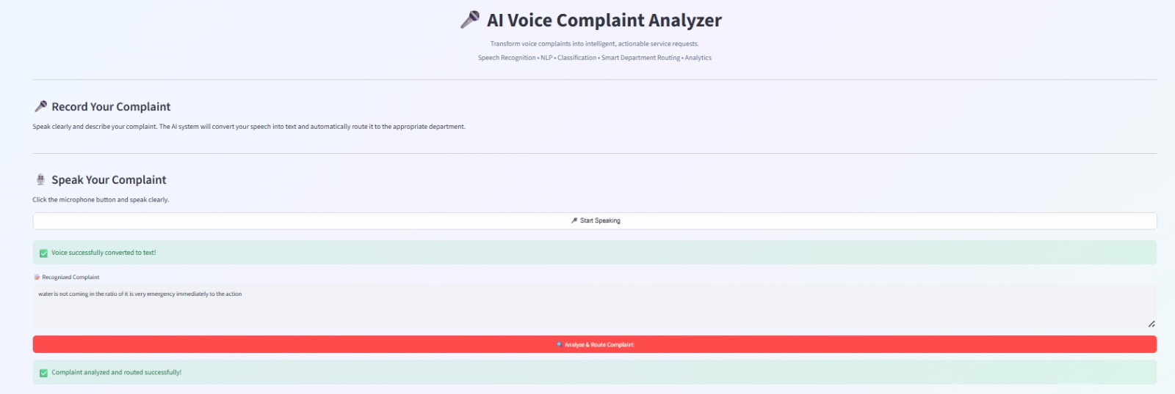
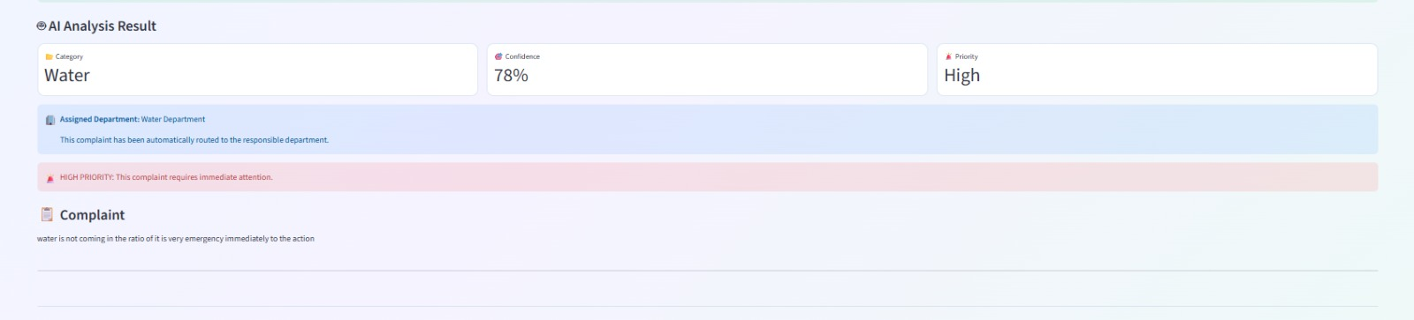
Implementation:

Slide 12
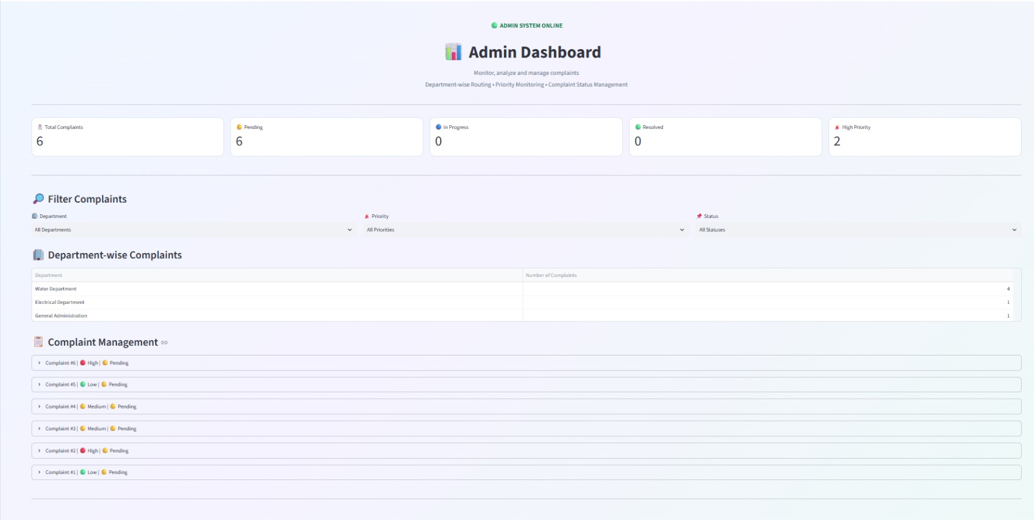

Slide 13
FUTURE ENHANCEMENTS
The system can be extended to support real-time video translation and dubbing.
It can support more Indian and international languages for wider accessibility.
It can use advanced AI models to improve translation accuracy and preserve context.
It can provide multiple voice choices, including different genders, accents, and speaking styles.
It can be deployed as a cloud-based platform so users can process videos from anywhere without depending on their local computer.

Slide 14

Conclusion
Converts unstructured spoken complaints into structured, actionable data automatically.
Emotion-aware prioritization ensures urgent, distressed complaints are handled first.
Automated department routing reduces manual effort and turnaround time.
Scalable NLP pipeline can be extended with multilingual and real-time dashboards in future work.
7

Slide 15
REFERENCES:
Bird, S., Klein, E., & Loper, E. (2009). Natural Language Processing with Python. O’Reilly Media.
Manning, C. D., Raghavan, P., & Schütze, H. (2008). Introduction to Information Retrieval. Cambridge University Press.
Pedregosa, F., et al. (2011). “Scikit-learn: Machine Learning in Python.” Journal of Machine Learning Research, 12, 2825–2830.
Rennie, J. D. M., Shih, L., Teevan, J., & Karger, D. R. (2003). “Tackling the Poor Assumptions of Naive Bayes Text Classifiers.” Proceedings of ICML, 616–623.
McCallum, A., & Nigam, K. (1998). “A Comparison of Event Models for Naive Bayes Text Classification.” AAAI-98 Workshop on Learning for Text Categorization, 41–48.
Jurafsky, D., & Martin, J. H. Speech and Language Processing. Reference text for speech recognition, NLP and language-processing concepts.
Nothman, J., Qin, H., & Yurchak, R. (2018). “Stop Word Lists in Free Open-source Software Packages.” Proceedings of the Workshop for NLP Open Source Software.
Google Cloud. Speech-to-Text Documentation. Reference for speech recognition and conversion of audio into text.
Rasa. Natural Language Understanding and Intent Classification Documentation. Reference for intent/category classification and confidence-based predictions.
Scikit-learn Developers. Feature Extraction and TF-IDF Documentation. Reference for TF-IDF vectorization and text feature extraction.

Slide 16
Thank You

